Slide 1
CIS8695 Managing Big Data Analytics
Nasim Mousavi
Assistant Professor
J. Mack Robinson College of Business
Georgia State University
nmousavi@gsu.edu

Slide 2
Dimension Reduction

Slide 3
Dimension
Dimension of a dataset refers to the number of variables in the dataset
Dimensionality of a model is the number of predictors (independent or input variables) used by the model
Dimension reduction
Also known as factor selection, feature extraction
Reduce the dimension of a dataset so that data mining algorithms can operate efficiently

Slide 4
Dimension Reduction Approaches
Incorporating domain knowledge to remove or combine categories
Which variables are most important for the task
Which variables are more likely to contain much error
Which variables will be available for measurements in the future
….

Slide 5
Dimension Reduction Approaches
Incorporating domain knowledge to remove or combine categories
Using regression models, regression and classification trees to remove redundant variables or combine similar categories of categorical variables

Slide 6
Regression-Based Dimension Reduction
Multiple Linear Regression or Logistic Regression
Use subset selection procedures to choose a subset of variables
Forward selection
Backward elimination
Stepwise regression
Combine similar categories
Having coefficients that are not statistically significant
Having similar coefficient values and same sign
Classification and regression trees
Determine the important predictors

Slide 7
Dimension Reduction Approaches
Incorporating domain knowledge to remove or combine categories
Using regression models, regression and classification trees to remove redundant variables or combine similar categories of categorical variables
Using data summaries to detect information overlap between variables (and remove or combine redundant variables or categories)

Slide 8
Data Summaries
Min, Max, Mean, Median, Std
Summaries can assist in
Combining categories of a categorical variables
Choosing variables to remove
Assessing the information overlap between variables
…

Slide 9
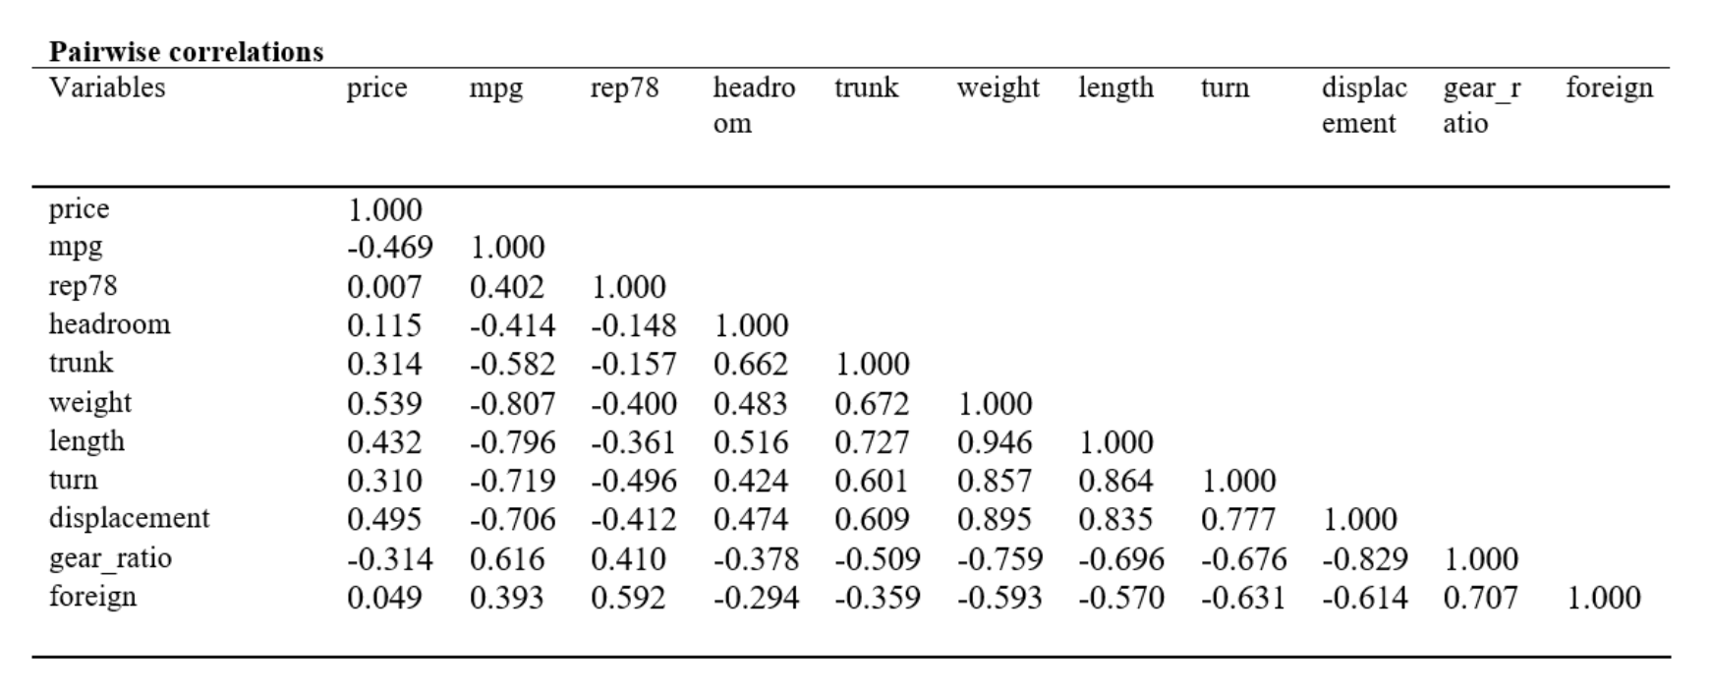
Correlation Analysis
For numerical variables, we can compute a matrix of correlation between each pair of variables
Shows the overlap in the information covered by the set of variables
Correlated variables are good candidates for data reduction by removing one them

Slide 10
Categories Combination
When a categorical variable has many categories (m), many models convert it to m-1 dummy variables
That can inflate the dimension of the data
One way to handle this is to reduce the number of categories by combining close or similar ones
This requires domain knowledge

Slide 11
Dimension Reduction Approaches
Incorporating domain knowledge to remove or combine categories
Using regression models, regression and classification trees to remove redundant variables or combine similar categories of categorical variables
Using data summaries to detect information overlap between variables (and remove or combine redundant variables or categories)
Use data conversion techniques such as converting categorical variables into numerical variables

Slide 12
Converting Variables
Sometimes the categories in a categorical variable represent intervals
Age (20,40)
Income bracket ($60K, $100K)
If the interval values are known (e.g., category 2 is the age interval 20-30), we can replace the categorical value with the mid-interval value (e.g., 25)
To reduce the number of dummy variables

Slide 13
Dimension Reduction Approaches
Incorporating domain knowledge to remove or combine categories
Using regression models, regression and classification trees to remove redundant variables or combine similar categories of categorical variables
Using data summaries to detect information overlap between variables (and remove or combine redundant variables or categories)
Use data conversion techniques such as converting categorical variables into numerical variables
Employing automated reduction techniques such as principal component analysis (PCA)

Slide 14
Principal Components Analysis (PCA)
A statistical procedure to summarize the information in large data using a smaller set of variables that can be more easily visualized and analyzed.
The smaller variables contain most of the information (variability) of data
Not losing too much information.

Slide 15
Principal Components Analysis
How does PCA do this?
Create new variables that are linear combinations of original variables
They are weighted averages of the original variables
These linear combinations are uncorrelated (no information overlap), and only a few of them contain most of the original information
The new variables are called principal components
Notes:
15

Slide 16
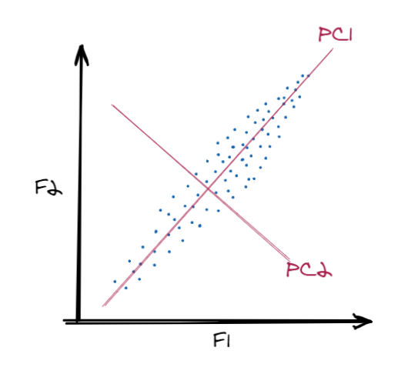
Principal Components Analysis
Notes:
17

Slide 17
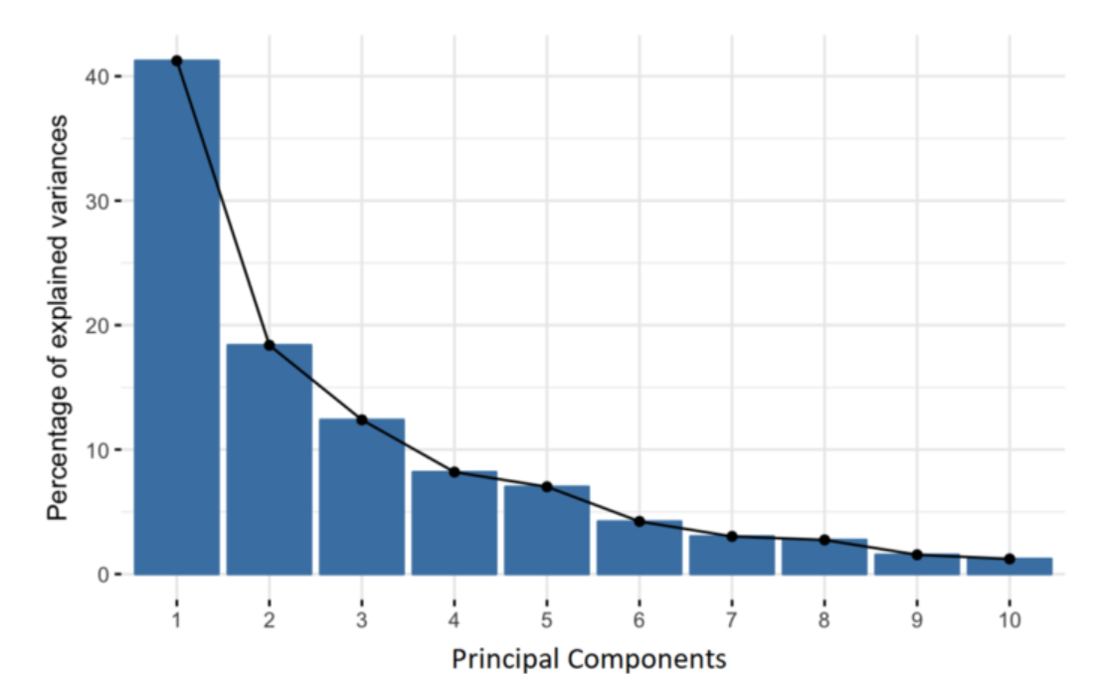
Principal Components Analysis
A n-dimensional data gives you n principal components
But PCA tries to put maximum possible information in the first component, then maximum remaining information in the second and so on, until having something like shown in the scree plot below
Notes:
17

Slide 18
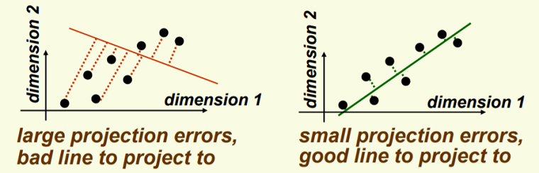
Finding the Best Linear Combination
Principal components find a linear combination of variables that explain a maximal amount of variance
That is to say, the lines that capture most information of the data
It’s the line that minimizes the distance with the points
Notes:
18

Slide 19
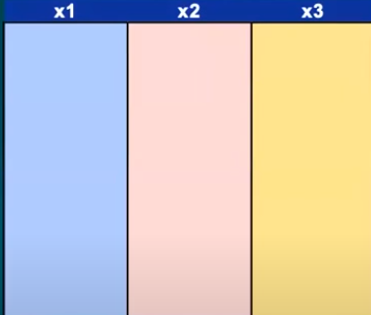
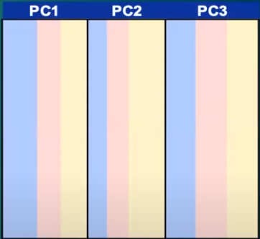
Simple Example
PC1 = a₁ x₁ + a₂x₂ + a₃x₃
PC2 = b₁x₁ + b₂x₂ + b₃x₃
PC3 = c₁x₁ + c₂x₂ + c₃x₃

Slide 20
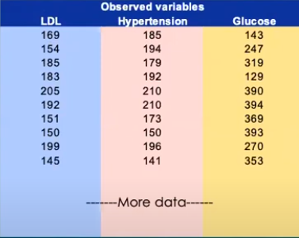
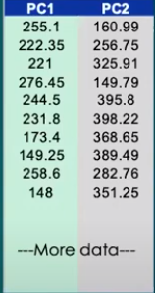
Simple Example
PC1 = 0.9LDL + 0.75 Hyp – 0.25 Glu
PC2 = 0.1LDL + 0.06 Hyp + 0.95 Glu
For the first row:
PC1 = 0.9*169 + 0.75*185 – 0.25*143 = 255.1
PC2 = 0.1*169 + 0.06*194 + 0.95*143 = 160.99

Slide 21
Example – Breakfast Cereals

Slide 22
Description of Variables
Name: name of cereal
mfr: manufacturer
type: cold or hot
calories: calories per serving
protein: grams
fat: grams
sodium: mg.
fiber: grams
carbo: grams complex carbohydrates
sugars: grams
potass: mg.
vitamins: % FDA rec
shelf: display shelf
weight: oz. 1 serving
cups: in one serving
rating: consumer reports

Slide 23
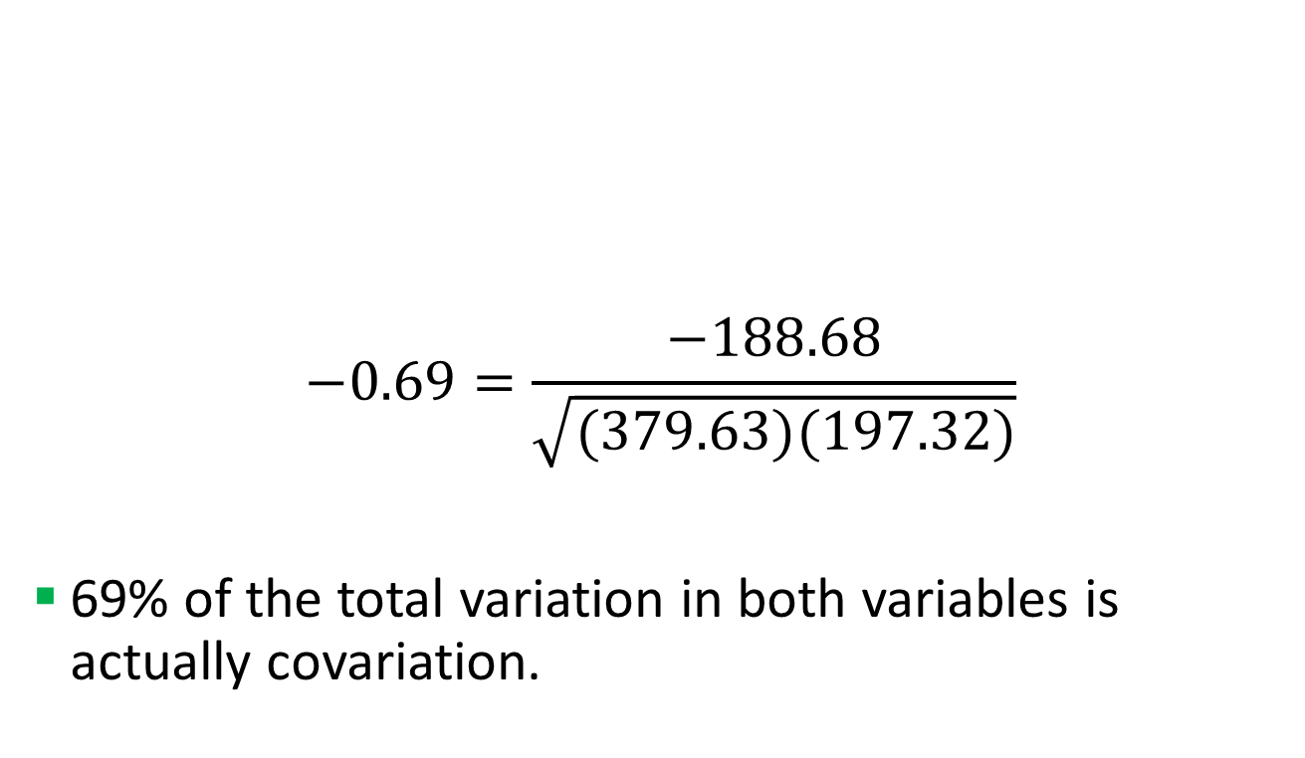
Correlation Between Calories and Rating
$$−0.69=\frac{−188.68}{\sqrt{(379.63)(197.32)}}$$
69% of the total variation in both variables is actually covariation.
 | Calories | Ratings
Calories | 379.63 | -188.68
Ratings | -188.68 | 197.32

Slide 24
Consider Calories & Ratings
The correlation between the two variables is 69%
69% of the total variation in both variables is co-variation (variation in one variable that is duplicated by similar variation in the other variable)
Can we reduce the number of variables, while making maximum use of the unique contribution of each variables?
PCA can find a linear relationship between these two that contains most of the information

Slide 25
First & Second Principal Components
Z₁ and Z₂ are two linear combinations.

Slide 26
PCA Output for these 2 Variables
Weights to project original data onto Z₁ & Z₂
e.g. (-0.847, 0.532) are weights for Z₁
Reallocated variance for new variables
Z₁ : 86% of total variance
Z₂ : 14% of total variance

Slide 27
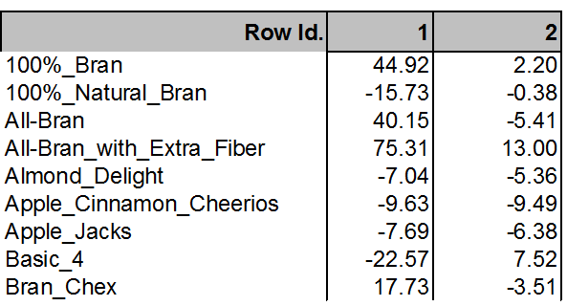
Principal Component Scores
Weights are used to compute the principal component scores
Scores are projected values variables onto the new axes
Barn cereal: 70 calories & 68.4 rating
Score= (-0.847)(70-106.88)+(0.532)(68.4-42.67)=44.92
Notes:
Subtract the means.

Slide 28
Numerical Data Needs to be Normalized
Need correlated independent variables
PCA on continuous variables
Data free from outliers
Variables should be in the same scales
Normalization (= standardization) is usually performed in PCA; otherwise, measurement units affect the results
Greater measurement (mgr vs. gr) results in higher variance
Higher variance will be a dominant component of the total variance

